Slide 1
Lesson objective
Calculators and whiteboards
Title: Experimental probability
Aim:
Assign probability based on experiments
Plan:
Review perimeter and volume
Unitary method
Assigning probability

Slide 2
Perimeter and volume
Measurement
Perimeter
Volume
Area
Description
The space inside a 3D shape
The space inside a 2D shape
The length of the boundary

Slide 3
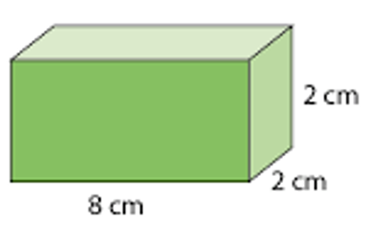
I do
A = l x b x h
5cm
7cm
7cm
11cm

Slide 4
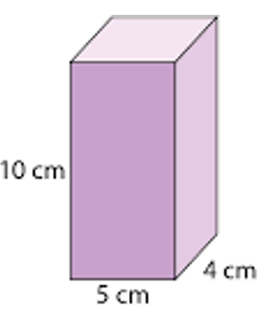
We do
8cm
7cm
11cm

Slide 5
Whiteboards
Calculate the perimeter:
12m
20m

Slide 6
Whiteboards
Calculate the perimeter:
12cm
11cm

Slide 7
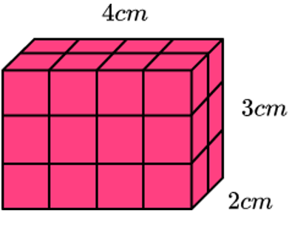

Whiteboards
Calculate the Volume: $V=l ×b×h$

Slide 8
TPS
Compare:
100g of Vegemite costs $2.40.
600g of Vegemite costs $15.
Which is cheaper and by how much?

Slide 9
Whiteboards
Compare:
100g of cheese costs $1.55
400g of cheese costs $6
Which is cheaper and by how much?

Slide 10
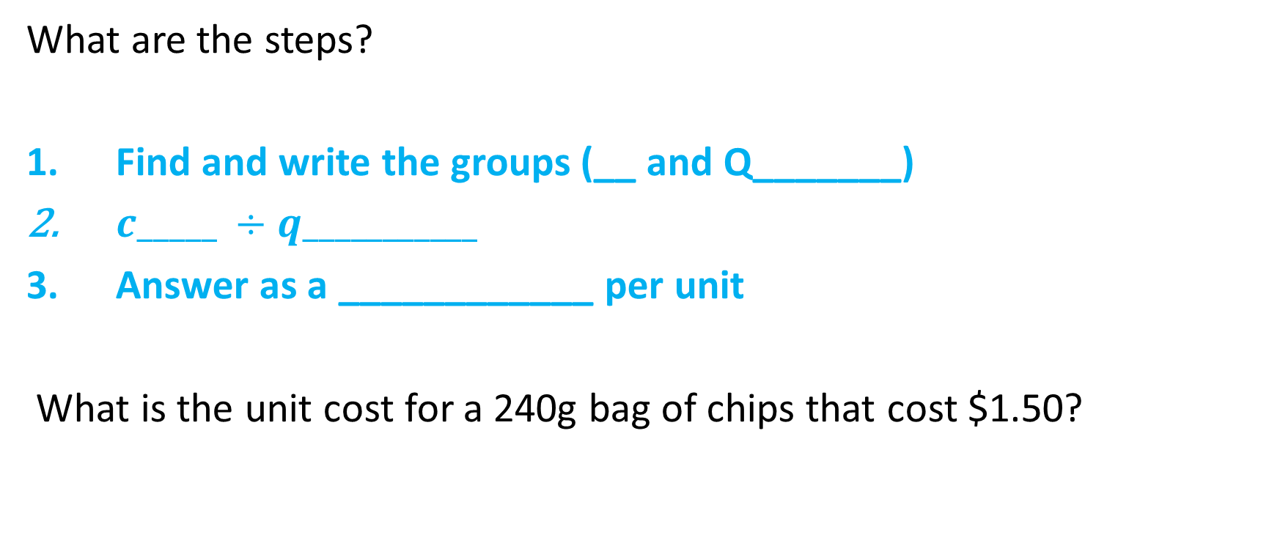
Unitary method
What are the steps?
Find and write the groups (__ and Q_______)
$c_____ ÷q___________$
Answer as a ____________ per unit
What is the unit cost for a 240g bag of chips that cost $1.50?

Slide 11
Whiteboards
Which is better value?
Option 1: 450g of cat food for $9
OR
Option 2: 740g of cat food for $13

Slide 12
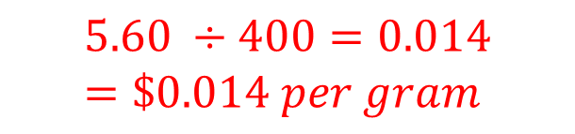


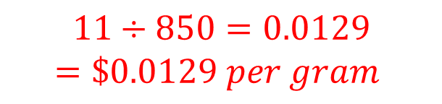
Compare
Find unit price ($cost ÷quantity)$ of each
Compare (smallest number is best buy)
Chips 400g for $5.60
Chips 850g for $11
$$5.60 ÷400=0.014$$
$$=\$0.014 per gram$$
$$11÷850=0.0129$$
$$=\$0.0129 per gram$$
$$850g chips are better value.$$

Slide 13
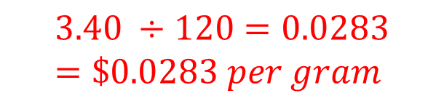

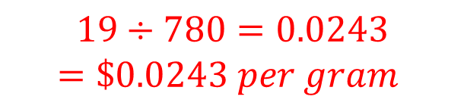
Compare
Find unit price ($cost ÷quantity)$ of each
Compare (smallest number is best buy)
Chocolate 120g for $3.40
Chocolate 780g for $19
$$3.40 ÷120=0.0283$$
$$=\$0.0283 per gram$$
$$19÷780=0.0243$$
$$=\$0.0243 per gram$$
$$780g chocolate is better value.$$

Slide 14
Probability
Theoretical
What we think should happen
Experimental
- What actually happens after an experiment

Slide 15
Example
John flipped a coin 100 times. These are his results:
Using these numbers, what is the probability that the next coin flip will be heads?
What was the theoretical probability? – how many would we expect?
 | HEADS | TAILS | TOTAL
TOTAL | 43 | 57 | 100

Slide 16
Draw a table: whiteboards and pair
We are rolling a normal 6-sided die
Roll the die 36 times and tally your results
 | 1 | 2 | 3 | 4 | 5 | 6
Tally
Total

Slide 17
Observations
If we did the same experiment, would be get the same results? Why?
What is your experimental probability of getting a 4?
What do we notice when we compare theoretical with experimental?

Slide 18
Individual task
Compete the unitary task sheet.

